Slide 1

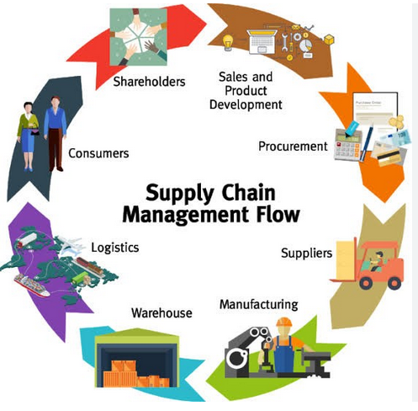
SUPPLY CHAIN DATA ANALYSIS USING MICROSOFT POWER BI
"Supply Chain Management (SCM) means managing all the steps needed to make and deliver a product or service — from getting raw materials to delivering the final product to the customer."

Slide 2
overview
Problem Statement
Datasets Used
Column Descriptions
ETL Process (Extract, Transform, Load)
Data Model Overview
Relationship diagram and explanation
Calculated Columns
Key Measures & KPIs
Visual insights
Conclusion
Recommendations

Slide 3
Problem statement
AtliQ Mart is losing key customers due to poor delivery service.
Essential products are often not delivered on time or in full.
This has led to non-renewal of annual contracts by some customers.
These delivery issues are damaging customer satisfaction and trust.
Management wants to fix the problem before expanding to new cities.
The supply chain team will track On-Time (OT%), In-Full (IF%), and On-Time In-Full (OTIF%) daily to monitor and improve performance.

Slide 4
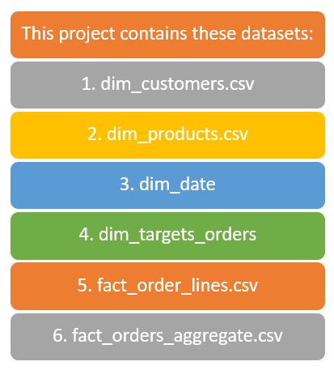
Datasets used

Slide 5
Columns descriptions
dim_customers: This table contains all the information about customers.
customer_id: Unique ID is given to each customer
customer_name: Name of the customer
city: It is the city where the customer is present
dim_products: This table contains all the information about the products
product_name: It is the name of the product
product_id: Unique ID is given to each of the products
category: It is the class to which the product belongs
dim_date: This table contains the dates at daily, monthly level and week numbers of the year
date: date at the daily level
mmm_yy: date at the monthly level
week_no: week number of the year as per the date column
dim_targets_orders: This table contains all target data at the customer level
customer_id: Unique ID that is given to each of the customers
ontime_target %: Target assigned for Ontime % for a given customer
infull_target %: Target assigned for infull % for a given customer
otif_target %: Target assigned for otif % for a given customer

Slide 6
Columns descriptions
fact_order_lines: This table contains all information about orders and each item inside the orders.
order_id: Unique ID for each order the customer placed
order_placement_date: It is the date when the customer placed the order
customer_id: Unique ID that is given to each of the customers
product_id: Unique ID that is given to each of the products
order_qty: It is the number of products requested by the customer to be delivered
agreed_delivery_date: It is the date agreed between the customer and AtliQ Mart to deliver the products
actual_delivery_date: It is the actual date AtliQ Mart delivered the product to the customer
delivered_qty: It is the number of products that are actually delivered to the customer
fact_orders_aggregate: This table contains information about OnTime, InFull and OnTime Infull information aggregated at the order level per customer
order_id: Unique ID for each order the customer placed
customer_id: Unique ID that is given to each of the customers
order_placement_date: It is the date when the customer placed the order
on_time: '1' denotes the order is delviered on time. '0' denotes the order is not delivered on time.
in_full: '1' denotes the order is delviered in full quantity. '0' denotes the order is not delivered in full quantity.
otif: '1' denotes the order is delviered both on time and in full quantity. '0' denotes the order is either not delivered on time or not in full quantity.

Slide 7
Data preprocessing
Extract - Imported datasets :
dim_customers.csv
dim_products.csv
dim_date
dim_targets_orders
fact_order_lines.csv
fact_orders_aggregate.csv
Transform
Renamed and standardized column names
Removed nulls and irrelevant columns
Merged tables
Created custom columns
Removed duplicates
Filtered unnecessary records
Load
Loaded all transformed tables into Power BI model
Created relationships
Measures Created

Slide 8
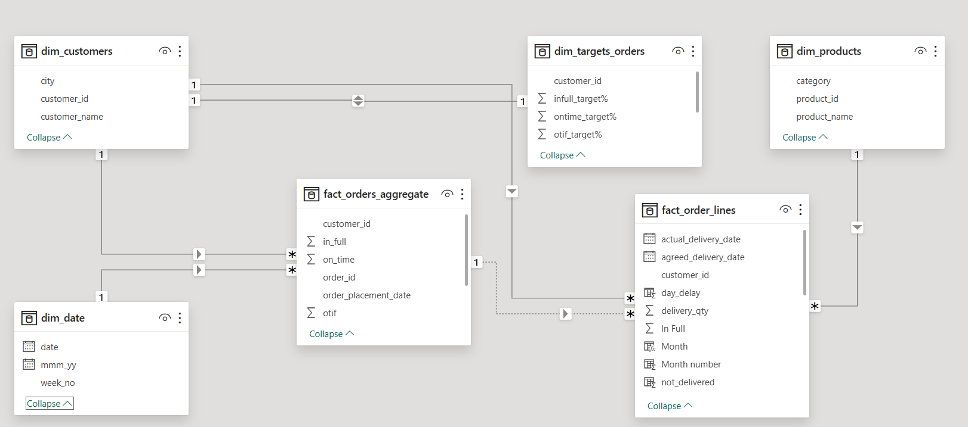
Data model overview

Slide 9

Calculated columns
DATEDIFF() - Used for: Calculating day delay between agreed_delivery_date and actual_delivery_date.
FORMAT() - Used for: Converting order_placement_date into Month name format (e.g., Jan, Feb).
MONTH() - Used for: Extracting month number from order_placement_date.
YEAR() - Used for: Extracting year from order_placement_date.
WEEKNUM() with CONCATENATE() - Used for: Creating Week Number labels (e.g., "W1", "W2", etc.).
Arithmetic Operation (-) - Used for: Calculating not-delivered orders = orders_qty - delivery_qty.

Slide 10

Key measures
VOFR% (Measures Volume Fill Rate.) –
CALCULATE(SUM(delivery_qty)) / SUM(order_qty)
IF% (Measures In-Full performance.) –
CALCULATE(COUNT(order_lines[In Full])) / COUNT(order_lines[Total])
OT% (Measures On-Time performance.) –
CALCULATE(COUNT(order_lines[On Time])) / COUNT(order_lines[Total])
OTIF% (Measures On-Time In-Full rate.) -
CALCULATE(COUNT(order_lines[On Time In Full])) / COUNT(order_lines[Total])
LIFR% (Measures Line Item Fill Rate.)
CALCULATE(COUNT(order_lines[In Full])) / [Total Order Line]
Target-Based KPIs:
IF_avg = AVERAGE(dim_target_orders[In Full %]) / 100
OT_avg = AVERAGE(dim_target_orders[On Time %]) / 100
OTIF_avg = AVERAGE(dim_target_orders[OTIF %]) / 100
Custom Measures
Total_order_line :
CALCULATE(COUNT(order_lines[order_id]))
Used as denominator for other performance metrics.

Slide 11
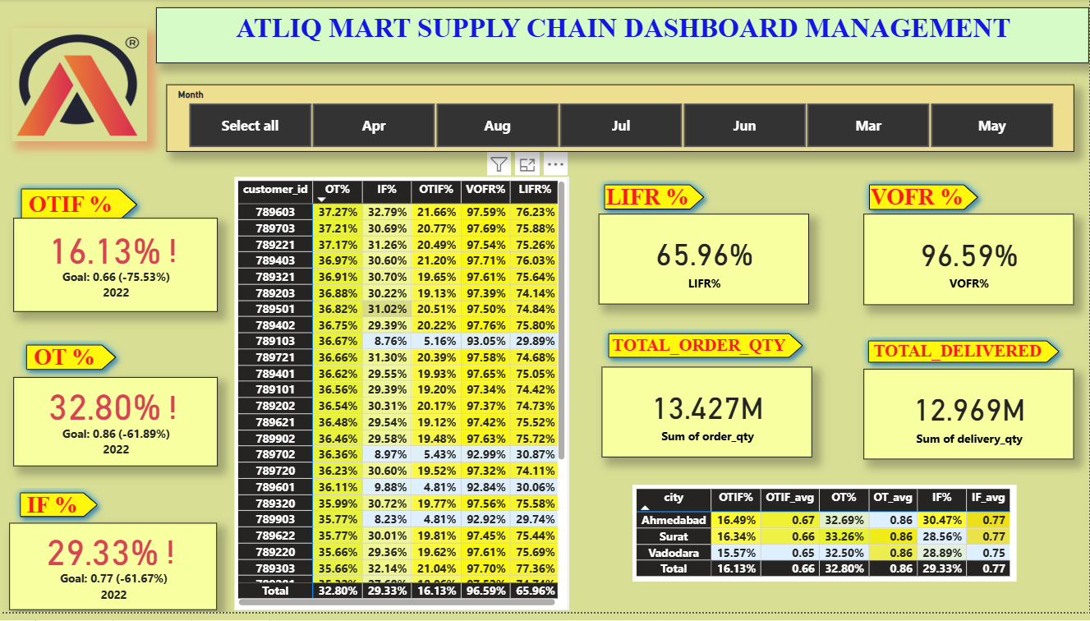
Main KPI & City-Wise Performance Overview
Analysis:
Poor delivery performance: OTIF (16.13%), OT (32.80%), and IF (29.33%) are far below targets, with many customers under 25%.
Systemic issue: Despite 96.59% volume delivered, low LIFR and poor OTIF across cities suggest widespread supply chain gaps

Slide 12
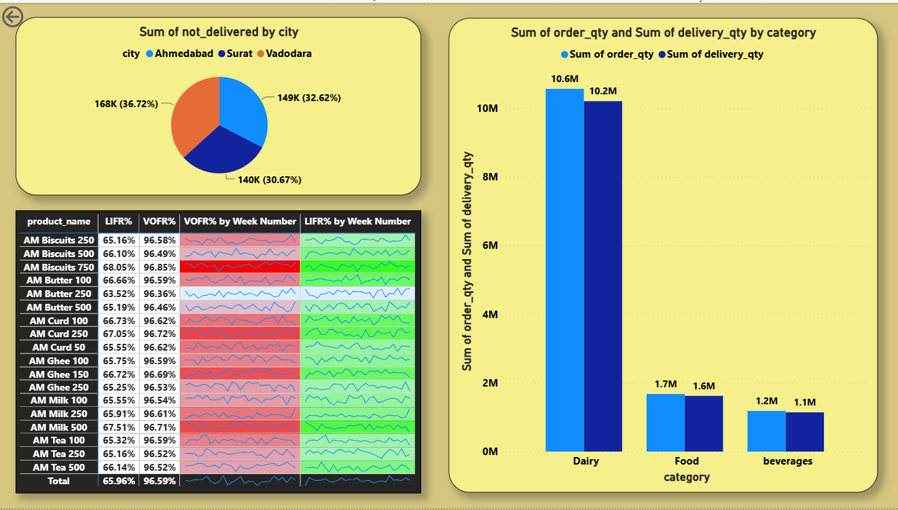
Non-Delivered Orders, Category-Wise Analysis, and Product-Level Trends
Analysis:
Surat faces highest delivery issues, contributing 36.72% of non-delivered orders; Dairy leads order volume, making it the biggest contributor to supply gaps.
LIFR remains unstable (~65–68%), with products like “AM Butter 250” underperforming; VOFR is consistently high (~96–97%), indicating timely quantity delivery but incomplete order lines.

Slide 13
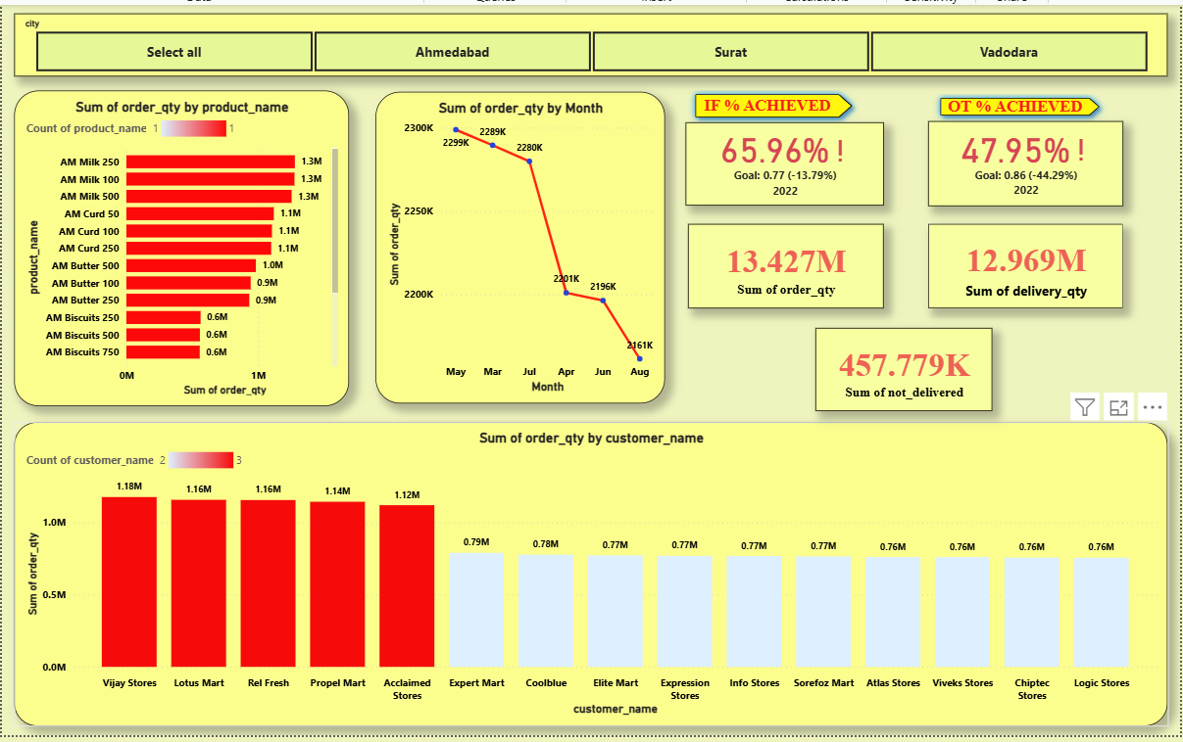
Product, Time, and Customer-Based Analysis
Analysis:
Milk SKUs drive majority of orders (1.1M–1.3M each); focus on top customers like Vijay Stores and Lotus Mart can significantly impact performance.
Order volume declining from May to August, with key service metrics (OT 47.95%, IF 65.96%) falling short of goals and 457K+ units undelivered.

Slide 14
conclusion
Overall service performance is poor with low OTIF (16.13%), OT (32.80%), and IF (29.33%).
High VOFR (96.59%) indicates quantity is shipped, but not on time or in full.
Surat leads in undelivered volume, pointing to logistical inefficiencies.
Dairy products dominate order volume, making them critical to supply chain success.
Top customers drive bulk of business — poor service here directly impacts revenue.
Monthly order volume is declining, signaling potential demand or operational issues.

Slide 15

recommendation
Optimize delivery timelines using route planning and better logistics coordination.
Improve warehouse operations to boost fulfillment accuracy (LIFR and IF%).
Strengthen Dairy supply chain, focusing on high-volume SKUs like AM Milk.
Prioritize top customers with tailored service levels and proactive issue resolution.
Analyze order drop trends and initiate demand generation or retention efforts.
Implement real-time monitoring via dashboards to flag OTIF issues early.

Slide 16


